Slide 1


Project 2019
Puzzle Bubble
Notes:
저도 조교하면서 실습을 먼저 강의하는 것은 처음. 슬퍼하지 마시고 너무..

Slide 2
Submission
Upload ETL
Attach a zip file of your project
Due date
By 11:59 pm, Tuesday, December 3rd

Slide 3
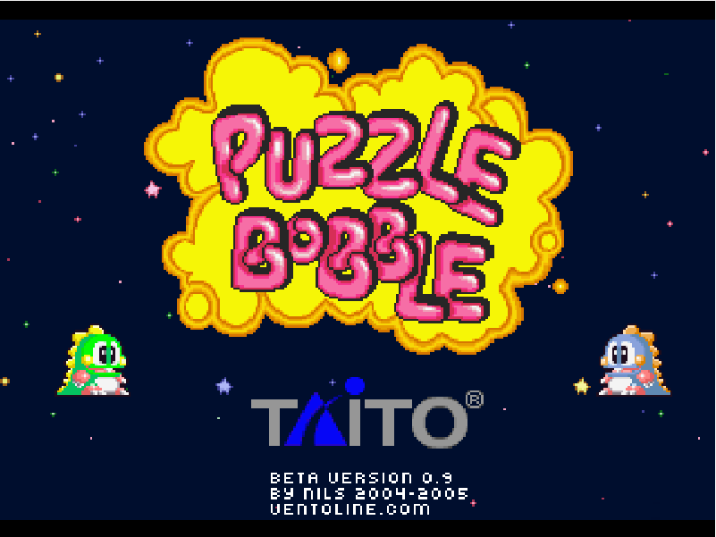
Exemplar
https://www.shooter-bubble.com/puzzle-bobble.php

Slide 4
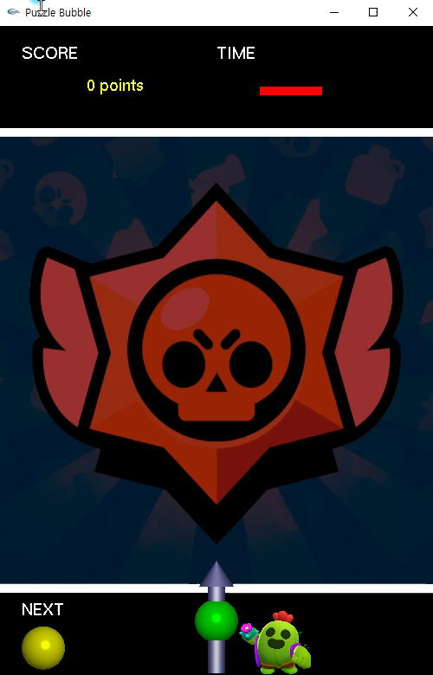
Demo

Slide 5
Game rules

Slide 6
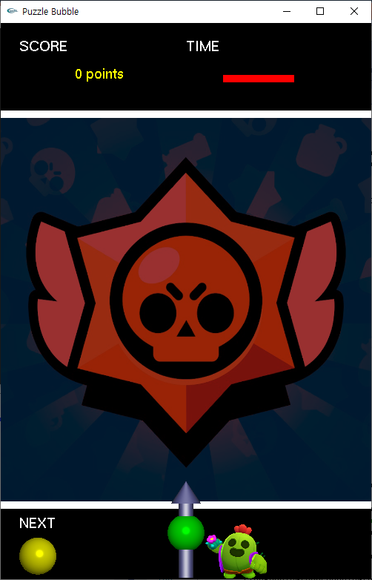
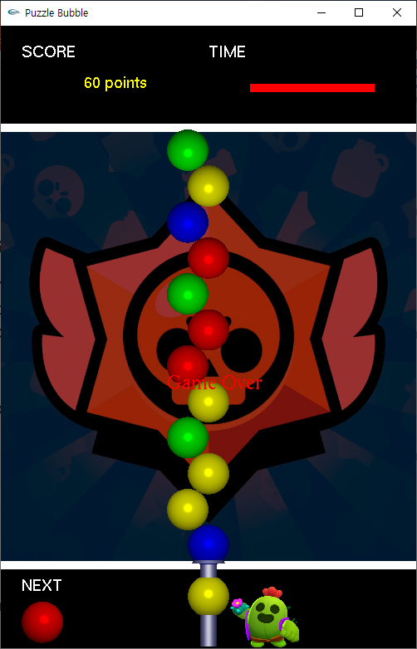
Specification
Start condition
Start bubble is placed on bubble shooter.
Next bubble lies near start bubble.
Number of bubble colors is 4 or more.
Defeat condition
Game is over if even a bubble reaches lower boundary.
Start bubble
Lower boundary
Next bubble

Slide 7
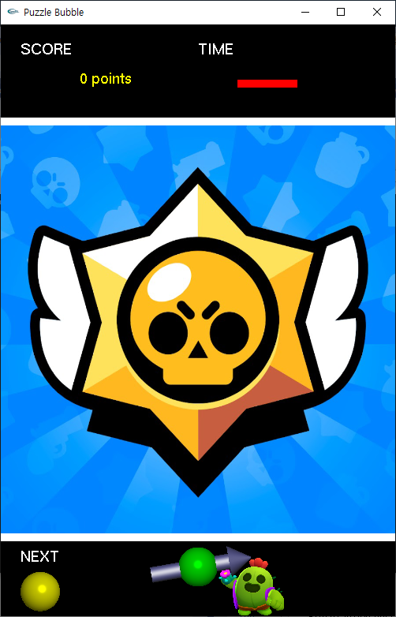
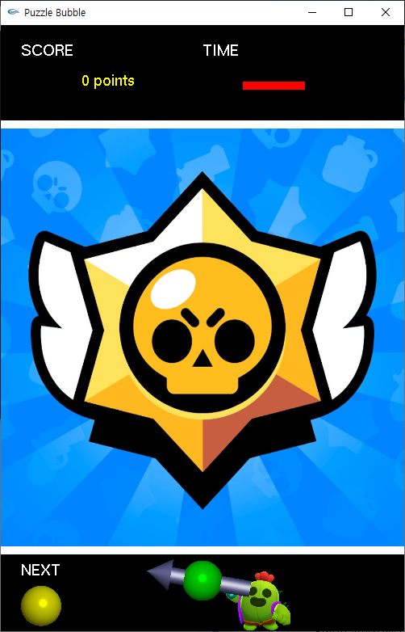
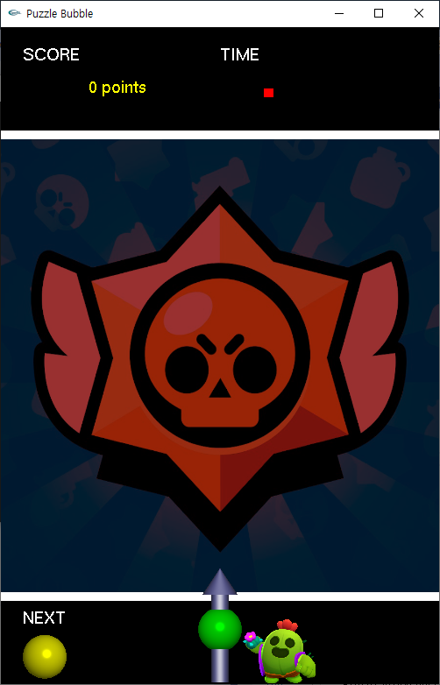
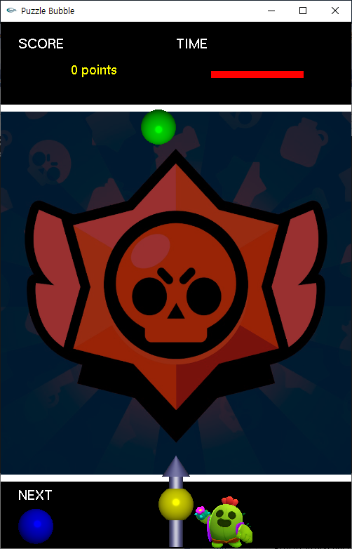
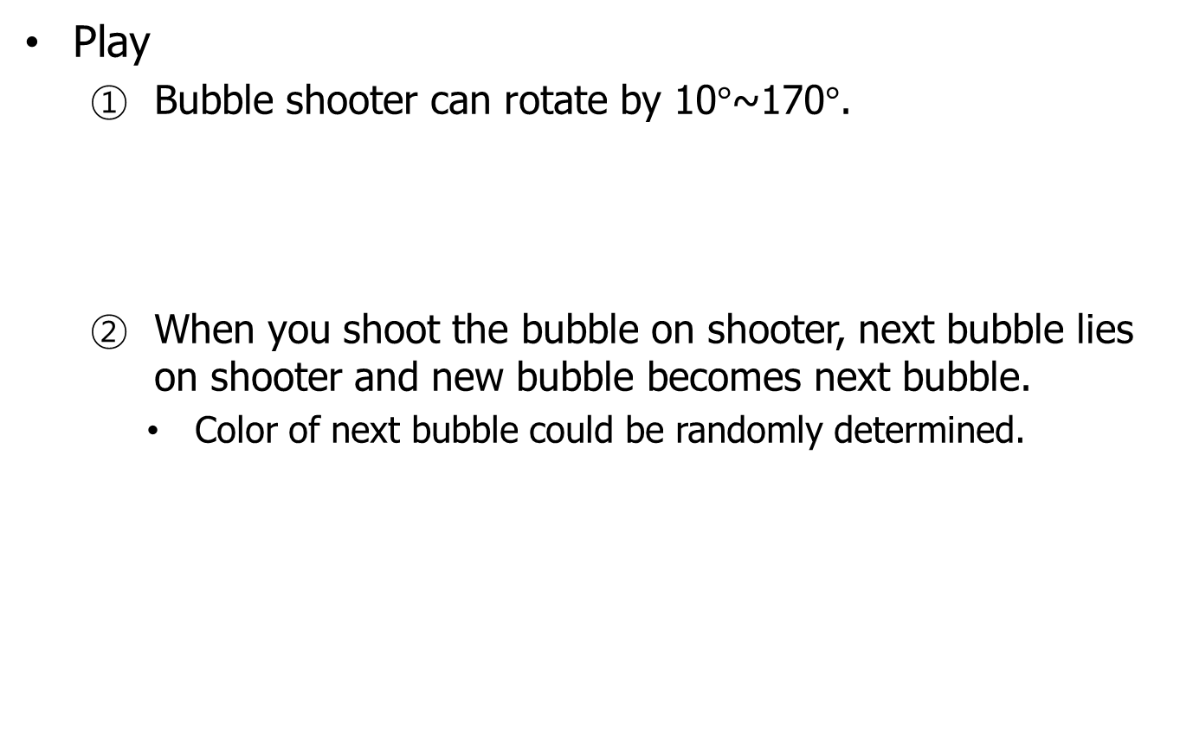
Specification
Play
Bubble shooter can rotate by 10$°$~170$°$.
When you shoot the bubble on shooter, next bubble lies on shooter and new bubble becomes next bubble.
Color of next bubble could be randomly determined.

Slide 8

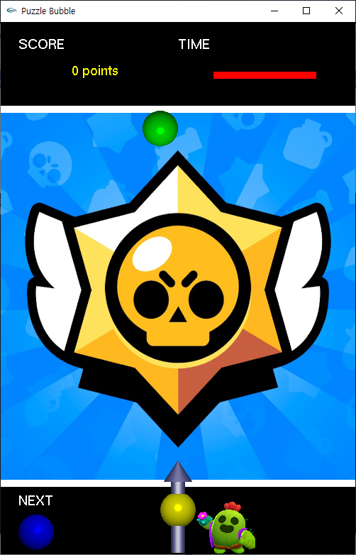
Specification
Play
The bubble you shot moves in the direction pointed by shooter.
If you don’t shoot before time runs out, bubble shooter automatically shoots the bubble.

Slide 9


Specification
Play
If the bubble collides with left/right boundary, it bounces off the boundary.

Slide 10
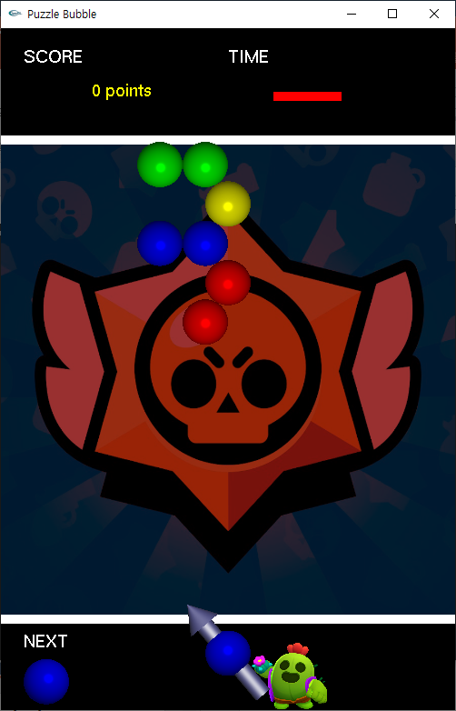
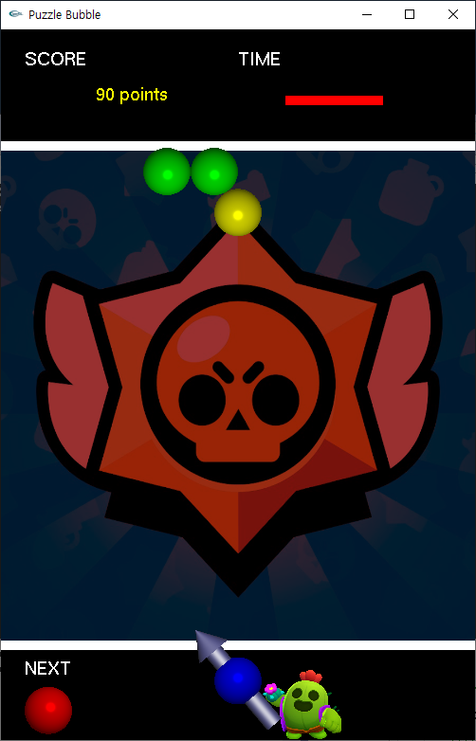
Specification
Play
The bubble stops moving when it reaches upper boundary or collides with another bubble.
When at least 3 bubbles of same color are connected, they are removed and bubbles which hang from them fall down.

Slide 11
Remove algorithm
recursion

Slide 12

Remove algorithm
1
1
: Last ball shot
$→$ store and search
1

Slide 13
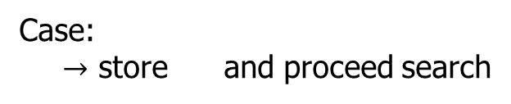
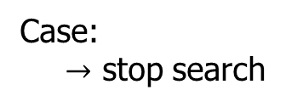
Remove algorithm
2
3
4
Case:
$→$ stop search
2
4
Case:
$→$ store and proceed search
3
3

Slide 14
Remove algorithm
5
6
7
8
Case:
$→$ stop search
6
7
8
Case:
$→$ store and proceed search
5
5

Slide 15
Remove algorithm
9
10
11
12
Case:
$→$ stop search
9
10
11
12
If the number of ball stored is equal to or more than 3, remove the balls

Slide 16
Drop algorithm
recursion

Slide 17
Drop algorithm
1
2
3
Traverse starting from
1
2
3

Slide 18
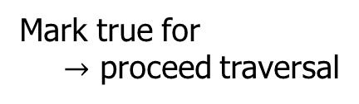
Drop algorithm
: true
1
4
5
6
Mark true for
$→$ proceed traversal
1

Slide 19
Drop algorithm
: true
7
4
8
Mark true for
$→$ proceed traversal
4

Slide 20
Drop algorithm
: true
7
Stop traversal because it is already true

Slide 21
Drop algorithm
: true
9
8
10
11
Mark true for
$→$ proceed traversal
8

Slide 22
Drop algorithm
: true
9
12
13
Mark true for
$→$ proceed traversal
9

Slide 23
Drop algorithm
: true
12
Stop traversal because it is already true

Slide 24
Drop algorithm
: true
13
14
Mark true for
$→$ proceed traversal
13

Slide 25
Drop algorithm
: true
15
14
Mark true for
$→$ proceed traversal
14

Slide 26
Drop algorithm
: true
15
Stop traversal because it is already true

Slide 27
Drop algorithm
: true
9
8
10
11

Slide 28
Drop algorithm
: true
10
Stop traversal because it is already true

Slide 29
Drop algorithm
: true
11
Stop traversal because it is already true

Slide 30
Drop algorithm
: true
7
4
8

Slide 31
Drop algorithm
: true
1
4
5
6

Slide 32
Drop algorithm
: true
5
Stop traversal because it is already true

Slide 33
Drop algorithm
: true
6
Stop traversal because it is already true

Slide 34
Drop algorithm
3
Mark true for and stop traversal
3

Slide 35
Drop algorithm
drop
If there are some balls which is marked false, they should to drop.

Slide 36
Scoring criterion
Implementation of OOP
3D drawing (lighting & shading)
Texturing (optional)
Specification
Bonus score
Game quality

Slide 37
References

Slide 38
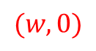
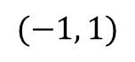
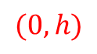
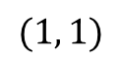
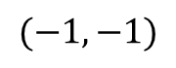
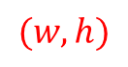
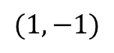
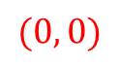
Converting screen coordinate
Before
After
$$(−1, 1)$$
$$(1, 1)$$
$$(0, h)$$
$$(w, h)$$
$$(−1, −1)$$
$$(1, −1)$$
$$(0, 0)$$
$$(w, 0)$$
glMatrixMode(GL_PROJECTION);
glLoadIdentity();
gluOrtho2D(0, w, 0, h); // 2D
glOrtho(0, w, 0, h, -10.0, 10.0); // 3D

